Slide 1
Data Mining for Business
Artificial Neural Networks.
Dr. Kamesam
Cognition: conscious mental activities : the activities of thinking, understanding, learning, and remembering

Slide 2



Data Mining / Machine Learning
Supervised Learning
Unsupervised
Learning
Classification
Regression
Clustering
Association Rules
Linear Regression
Nonlinear Regression
DT
C&RT
Logistic Regression
ANN
today

Slide 3

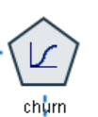

Logistic Regression for Classification
Features
Data
Learner
(ML algorithm)
Classifier
(model)
Target
Output

Slide 4
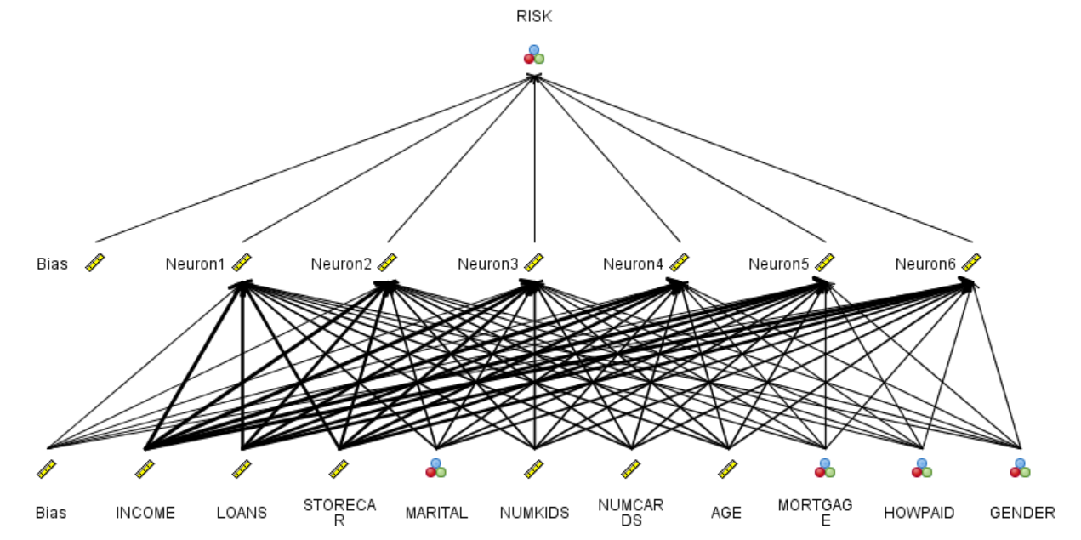



Artificial Neural Net for Classification
Features
Data
Learner
(ML algorithm)
Classifier
(model)
Target
Output
Notes:
Inductive learning

Slide 5
Artificial Neural Networks (ANN)
Reference Materials:
Introduction to IBM SPSS modeler and Data mining
this document is on BB
Suggested Reading for ANN
Sec 4.7 in Textbook (Tan et. al )
Algorithmic Guide SPSS Modeler (on BB)
Chapter 26 on Neural Network Algorithms
Related Materials on Blackboard
3 articles on Neural Networks including “Deep Learning”

Slide 6
INTRODUCTION Biological Motivation
Human brain is a densely interconnected network of approximately 10¹¹ (100 billion) neurons, each connected to, on average, 10⁴ (ten thousand) others.
A Neuron is a cell that performs information processing in the brain
Neuron activity is excited or inhibited through connections to other neurons.
The fastest neuron switching times are known to be on the order of 10⁻³ sec.

Slide 7
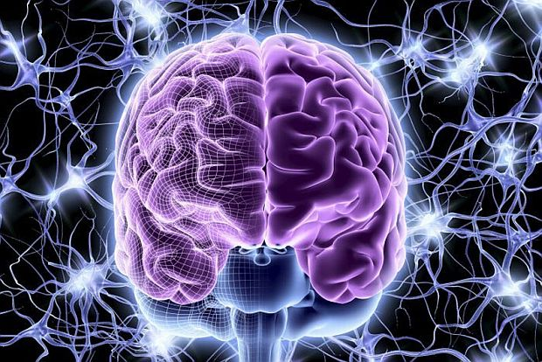
Neural Network

Slide 8
Introduction
Traditional computers are very good at number crunching, but not so good at cognitive tasks.
Human brain, on the other hand, is very good (and fast) at cognitive tasks, but cannot do computing tasks like a computer
In order to build computer systems that can “learn”, it is a tempting idea to mimic the human brain.
The brain can fire all the neurons in a single step.
----- Parallelism
Serial computers require billions of cycles to perform some tasks that the human brain takes a fraction of a second.
e.g. Face Recognition

Slide 9
Definition of Neural Network
A Neural Network is a system composed of
many simple processing elements operating in
parallel which can acquire, store, and utilize
experiential knowledge.

Slide 10
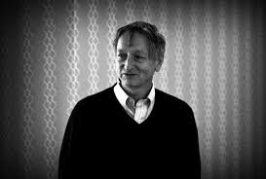
Geoffrey Hinton
Significant contributions to Artificial Neural Networks and Deep Learning
2018 Turing Prize Winner

Slide 11
Biological neuron
A neuron has
A branching input (dendritic tree) to which other neurons connect
A branching output (the axon) to other neurons
The information circulates from the dendrites to the axon via the cell body
Axon connects to dendrites via synapses
Synapses vary in strength
Synapses may be excitatory or inhibitory
Synapse is where a signal passes from one nerve cell to another

Slide 12
Machine Learning Abstraction

Slide 13
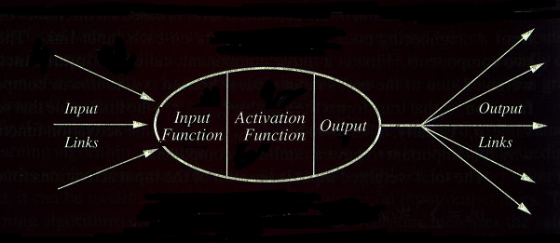
Computing Units
A typical unit:

Slide 14
Single Neuron
x₁
x₀
Bias (x₀ =1,always)
w₁
w₀
x₂
w₂
Activation function
Inputs
output
Σ
φ(.)
x₃
w₃
y
x₄
Summing function
*
w₄
x_{m}
w_{m}
Notes:
*W0+求和n=1w1*x1 because x0=1 we can get *line
Bias 最初引入的偏差值

Slide 15
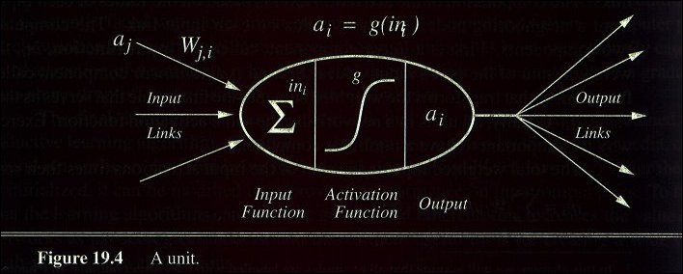
A Computing Unit.
Now in more detail but for a particular model only

Slide 16
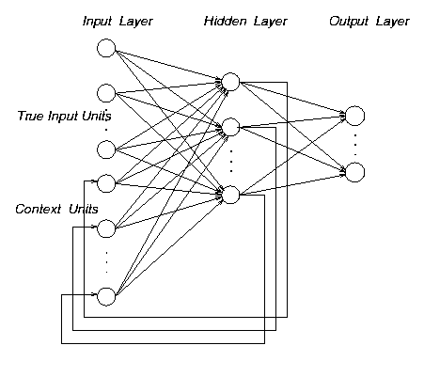
Topologies of Neural Networks
completely connected
feedforward
(directed, a-cyclic)
recurrent
(feedback connections)
Notes:
Mögliche Topologien für Neuronale Netze:
- vollständig vernetzt: Selbstassoziative Netze (Hopfield)
feedforward: vielparametrisierter Approximator
Yellow 有等级 different layer
Recurrent(负反馈)
- recurrent: zur Modellierung zeitveränderlicher Signale
Für die Approximation zeitkonstanter Signale werden meist vorwärtsgerichtete Neuronale Netze eingesetzt. Darauf beschränken wir uns auch im weiteren...

Slide 17
Artificial Neural Networks
We will learn a computing model inspired by the biological neural network. However, everything we will learn today is implemented in software, on traditional computers.
There are some research projects that implement neural networks in hardware (IBM synapse, others)
ANN are a popular learning model for Supervised Learning (Classification, as well as Regression)
Recent Developments in Deep Learning are based on ANN

Slide 18
Prototypical Feed Forward Artificial Neural Networks
The information is propagated from the inputs to the outputs
Most nonlinear functions can be learnt from this ANN archtecture.
Where is the learning ?
The Learning is stored in the weights on each connection between layers
Output layer
2nd hidden
layer
1st hidden
layer
Input
layer
x1
x2
…..
xn

Slide 19
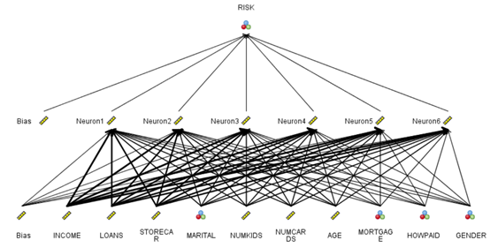
Single hidden layer ANN for classification

Slide 20
Artificial Neural Networks
Attraction: Their ability to generalize and learn from data “mimics” a human’s ability to learn from experience.
Drawback: Not easy to explain to most people.
Black Box
Very useful in Data Mining…better results are the hope
Can handle Noisy data well
Long training times may be needed
Once training is done, Evaluation is Fast.
Classification as well as Regression functions

Slide 21
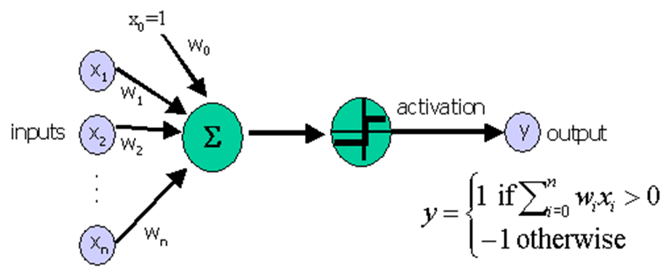
Perceptrons
The perceptron is a type of artificial neural network which can be seen as the simplest kind of feed forward neural network with a single Neuron: a linear classifier.
Introduced in the late 50s.
Perceptron convergence theorem Rosenblatt 1962: Perceptron will learn to classify any linearly separable set of inputs.

Slide 22
Simple Neural Networks
Linear regression
A single neuron
Activation function: Φ(Σ) = Σ (just pass through the sum)
– Output:
Linear in inputs: weighted sum (maybe plus a constant)
Logistic regression
Same as above, but
Activation function is Φ(Σ) = 1/(1+e^{-Σ})
Output:
Non-linear (“squashed”) weighted sum of inputs

Slide 23
Activation Functions
Perceptron
Linear Regression
Sigmoid (Logistic)

Slide 24
Multi-Layer Networks
Multi-layer networks can represent arbitrary functions, but an effective learning algorithm for such networks was thought to be difficult.
A typical multi-layer network consists of an input, hidden and output layer, each fully connected to the next, with activation feeding forward.
The weights determine the function computed. With 2 hidden layers, any nonlinear function can be approximated.
In IBM SPSS Modeler, ANN are referred to as Multi-Layer Perceptrons
output
hidden
activation
input

Slide 25
A Single Neuron with Sigmoid activation
Inputs
Output
Age
34
.5
0.6
.4
Σ
Gender
1
“Probability of beingAlive”
4
.8
Stage
Independent variables
Coefficients
Prediction
Features
Notes:
25

Slide 26
Multi-Layer Network
Inputs
Output
Age
34
.6
.4
.2
Σ
0.6
.1
.5
Gender
2
Σ
.3
.2
.8
.7
Σ
“Probability of beingAlive”
Stage
4
.2
Dependent variable
Prediction
Independent variables
Weights
HiddenLayer
Weights
Notes:
26

Slide 27
Getting an answer from a NN
Inputs
Output
Age
34
.6
.5
0.6
.1
Gender
2
Σ
.7
.8
“Probability of beingAlive”
Stage
4
Dependent variable
Prediction
Independent variables
Weights
HiddenLayer
Weights
Notes:
27

Slide 28
Getting an answer from a NN
Inputs
Output
Age
34
.2
.5
0.6
Gender
2
Σ
.3
.8
“Probability of beingAlive”
Stage
4
.2
Dependent variable
Prediction
Independent variables
Weights
HiddenLayer
Weights
Notes:
28

Slide 29
Getting an answer from a NN
Inputs
Output
Age
34
.6
.2
.5
0.6
.1
Gender
1
Σ
.3
.7
.8
“Probability of beingAlive”
Stage
4
.2
Dependent variable
Prediction
Independent variables
Weights
HiddenLayer
Weights
Notes:
29

Slide 30
ANN can be trained for Regression or Classification
Predicting continuous variables
Supply attribute values at input nodes
Obtain predictions from the output node(s)
Predicting classes
Two classes : single output node with threshold
Multiple classes: multiple outputs, one for each class
Predicted class = output node with highest value
“Universal approximator ”: Combination of simple non-linear units gives amazing flexibility

Slide 31
Training a NN: What does it learn?
It learns the function that best translates inputs into outputs given its architecture
The learning is embodied in the set of weights
The training is iterative. Starting with some initial weights:
For each training example, calculate the output, calculate the error
Adjust the weights based on error
Go to next example and repeat the process, till the error is sufficiently small, or the weights converge
“epoch” : One round of training on all samples

Slide 32
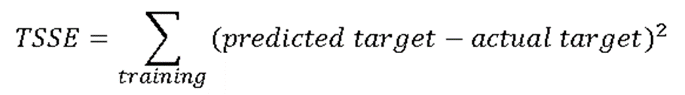
Back Propagation Algorithm
Define
Randomly choose the initial coefficients
Repeat while TSSE is too large
For each training record (presented in random order)
Apply the inputs to the ANN
Calculate the output for every neuron from the input layer, through the hidden layer(s), to the output layer
Calculate the error at the outputs
Use the output error to compute error signals for pre-output layers
Use the error signals to compute coefficient adjustments
Adjustment the coefficients
Go back to Repeat

Slide 33

Perceptron Training Rule
Update weights by:
where
η is the learning rate
a small value (e.g., 0.1)
sometimes is made to decay as the number of weight-tuning operations increases
t – target output for the current training example
o – linear unit output for the current training example

Slide 34
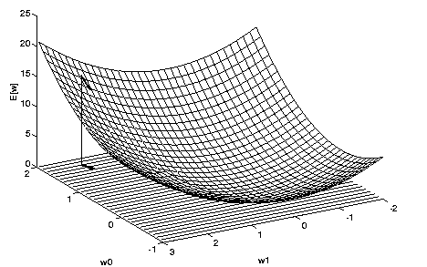
Figure 5. The error surface
How can we calculate the direction of steepest descent along the error surface? This direction can be found by computing the derivative of E w.r.t. each component of the vector w.

Slide 35
ANN: Strengths & weakness
Can model very complex functions, very accurately – non-linearity is built into the model
Handles noisy data well
Making predictions is fast
calculate a mathematical function
Training time often is reasonable
but still considerable
As mentioned earlier, A Black Box

Slide 36
ANN can learn complex nonlinear separation boundaries
Examples: all with 2 features so you can see the plot

Slide 37
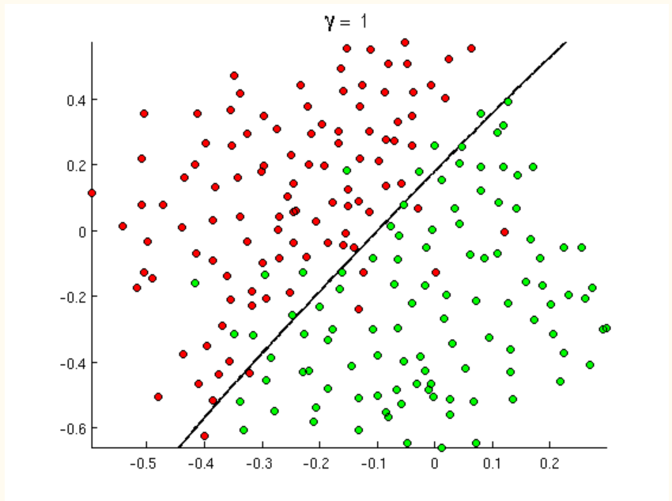
Linear separation boundary

Slide 38
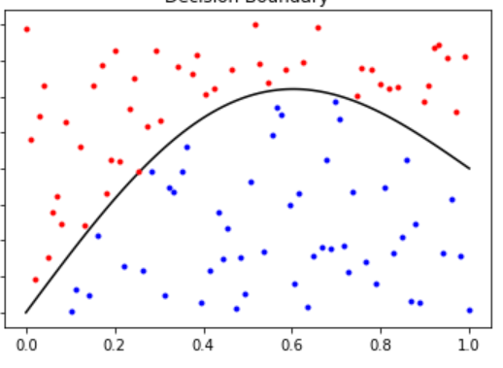
Nonlinear separation boudary

Slide 39
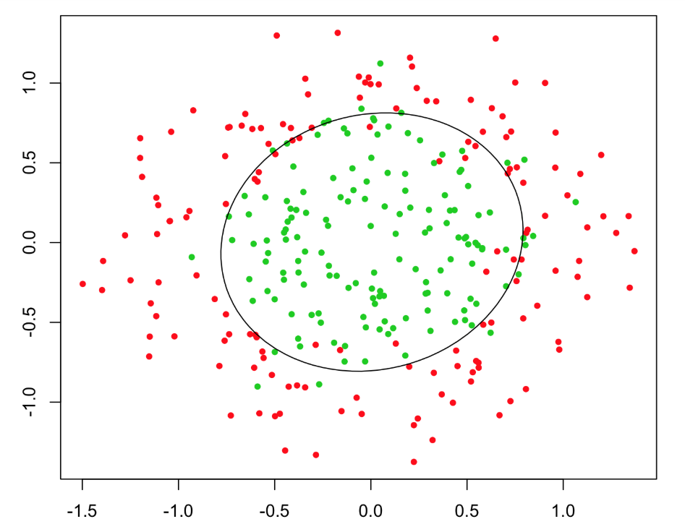
Nonlinear separation

Slide 40
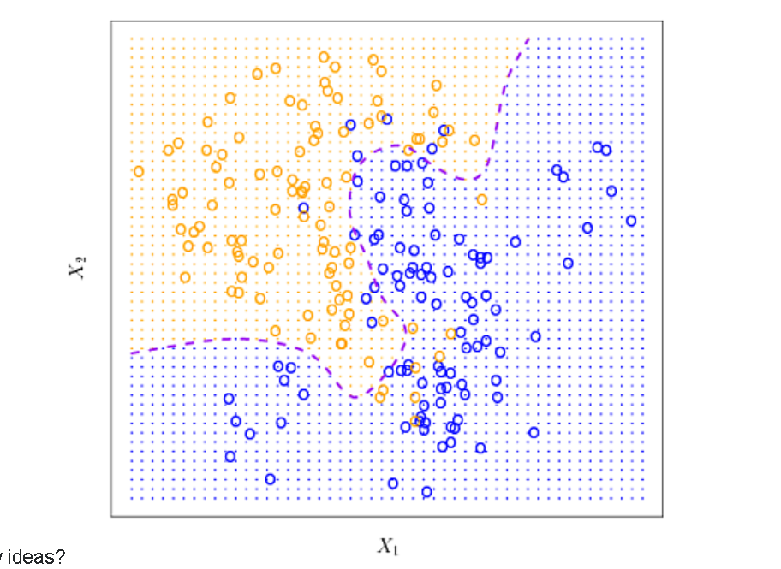
Nonlinear separation

Slide 41
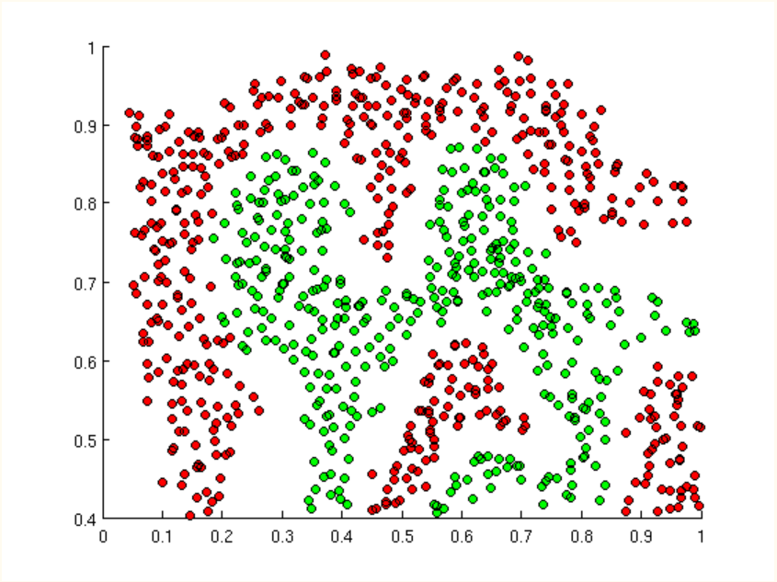
Nonlinear separation

Slide 42
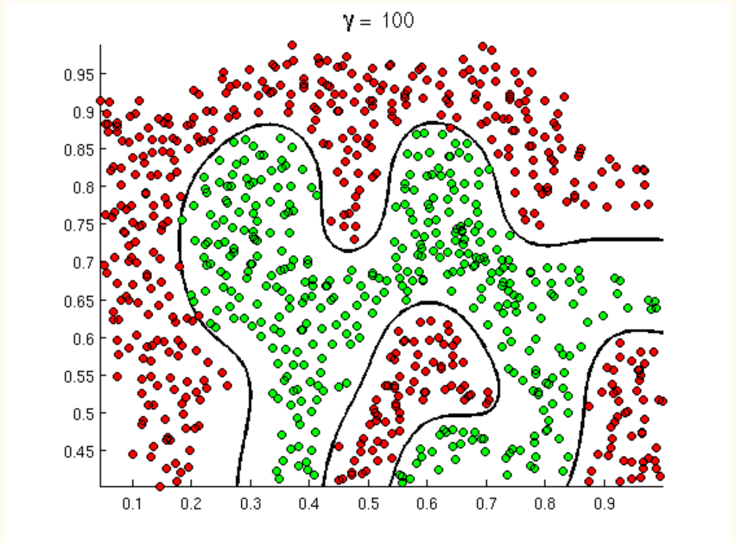
Nonlinear separation

Slide 43
Successful Applications
Text to Speech (NetTalk) https://www.aaai.org/Papers/MAICS/2000/MAICS00-015.pdf
Fraud detection
Financial Applications (FICO credit score)
HNCsoftware (eventually bought by Fair Isaac)
Credit approve / disapprove models
Chemical Plant Control
Pavillion Technologies
Driverless Vehicles
Game Playing
Neurogammon
Handwriting recognition

Slide 44
How many hidden layers ?
Zero hidden layers
Simple Perceptron
Can correctly classify any Linearly separable dataset
One hidden layer
Suitable for a single convex region of the decision space
Two hidden layers
Can generate any arbitrary decision boundary

Slide 45
Neural Nets with SPSS Modeler
SPSS modeler calculates number of neurons in the hidden layer as
Max(3, (#input neurons+#output neurons)/2)
. You can ask for 2 hidden layers and you need to specify
the number of Neurons in each Layer
SPSS Neural Nets normalizes the input as
X = (X – min(X)) /(Max(X) – Min(X) )
You can specify stopping rule
Number of minutes of running time
Number of iterations
Size of error

Slide 46
End Of Lecture
SPSS Demo

Slide 47
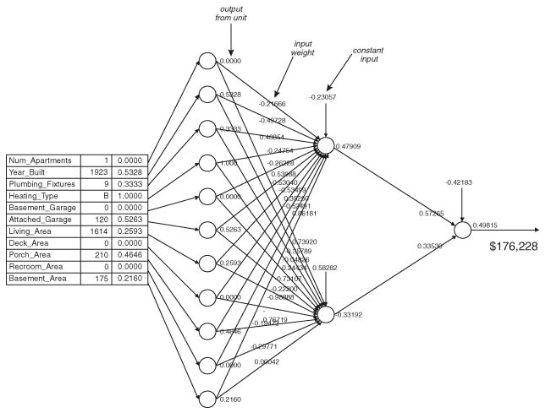
Loan Appraiser - revisited
Illustrates that a neural network (feed-forward in this case) is filled with seemingly meaningless weights
The appraised value of this property is $176,228 (but it is not easy to explain how it was arrived at)

Slide 48
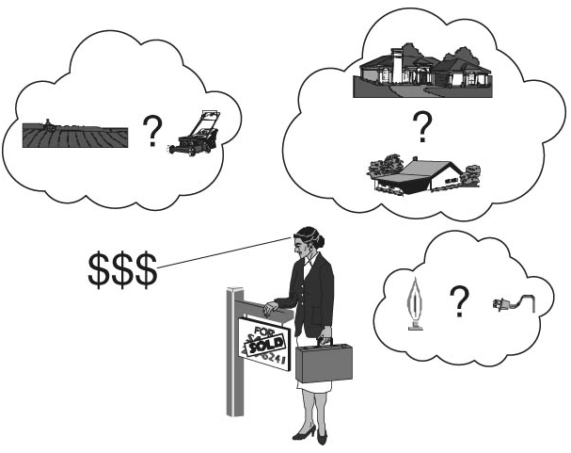
Real Estate Appraiser

Slide 49
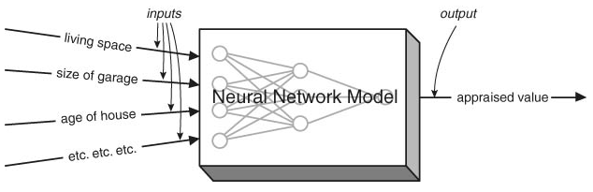
Loan Prospector
Regression
A Neural Network is like a black box that knows how to process inputs to create a useful output.
The calculation(s) are quite complex and not easy to interpret

Slide 50
ANN examples in WEKA
Prediction function example
Cpu.arff, 6 attributes, output is numerical
When the output is numerical, ANN does not use the sigmoid function on the output node.
For prediction, first try a Linear regression, get an idea, then try ANN
Classification
Wisconsin breast cancer data
output {benign, malignant}

Slide 51
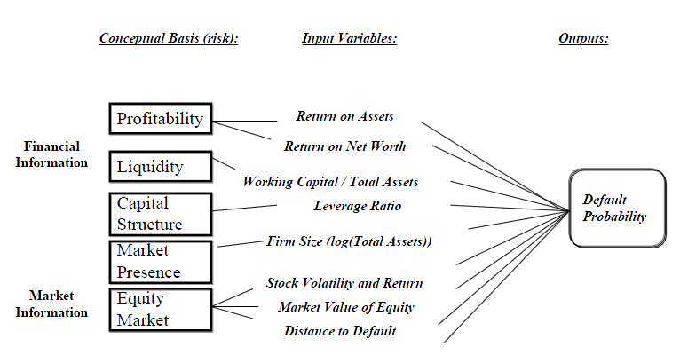
Feature Engineering: Example of Predicting Debt Default
Appropriate formulation of input variables is crucial

Slide 52
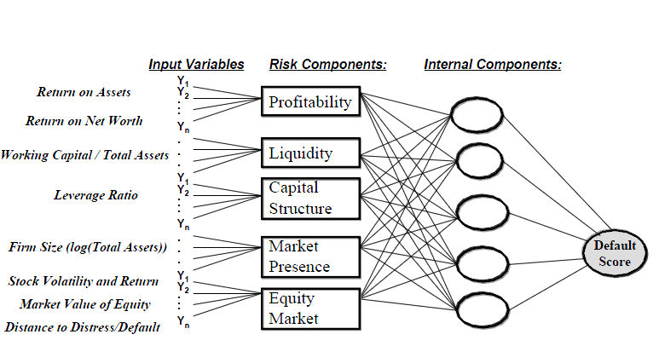
A Nonlinear Prediction Model

Slide 53
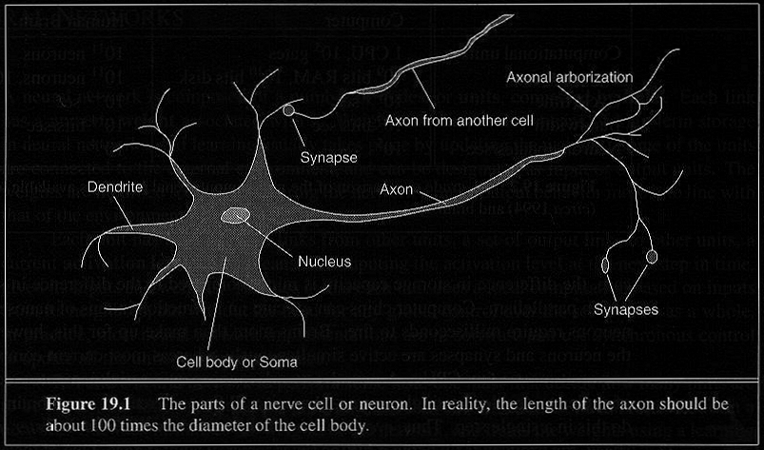
How Does the Brain Work ? (2)
Each consists of :
SOMA, DENDRITES, AXON, and SYNAPSE.

Slide 54
Multiple Linear Regression
For the Houseprices.xls data, we fit a Linear Regression model as follows:
Houseprice= 136.79 + 276.08 * propertysize
+ 0.129 * HouseSize -1.399 * Age
The general form of a linear regression model is
Y = b₀ + b₁* X₁ +b₂* X₂ + …………… +b_{n}* X_{n}
where Y is the target (dependent variable) and X₁ , X₂, ……., X_{n} are the explanatory variables

Slide 55
What is an artificial neuron ?
Definition : Non linear, parameterized function with restricted output range
y
w0
f is an activation function to be defined
x1
x2
x3

Slide 56
Neural Nets: Weaknesses
A “black-box” -- Hard to explain or gain intuition
For complex problems, training time could be quite high
Highly prone to over fitting.
Often requires substantial “fiddling”
feature engineering
create (normalized) meaningful, numeric inputs
parameter selection/tuning
best used in the hands of a neural network expert
Network topology has to be specified by user.

Slide 57

Neural Network Learning
Learning approach based on modeling adaptation in biological neural systems.
Perceptron: Initial algorithm for learning simple neural networks (single layer) developed in the 1950’s.
Backpropagation: More complex algorithm for learning multi-layer neural networks developed in the 1980’s.

